Slide 1
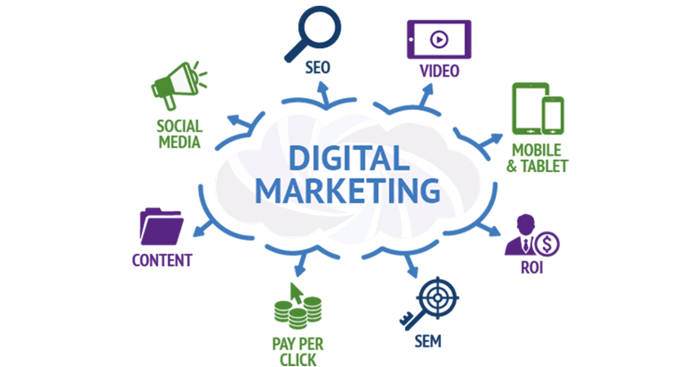
Project 3: Run a Facebook Campaign (Part 2)
Laavanya Ganesh
THE ONLY FASHION THAT NEVER DIES

Slide 2
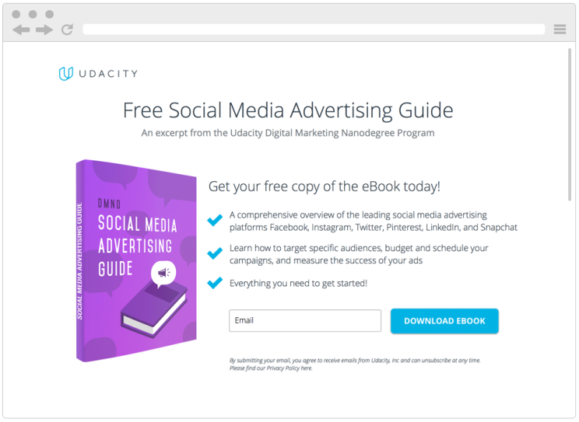
Digital Marketing Nanodegree Program
You are tasked with attracting future fellow students for this Digital Marketing Nanodegree Program. More specifically, your objective is to collect email addresses of potential students, who could be interested in taking this course. In order to do this, we have created a landing page, where prospective students can download a free eBook if they provide us with their email address. The eBook – a Social Media Advertising Guide – is a short excerpt from the Digital Marketing Nanodegree Program, content that you will see in the Social Advertising course. For the purpose of the projects, assume costs of $0 for the eBook and a conversion value (revenue) of $15 per collected email address.

Slide 3
CAMPAIGN APPROACH
The project challenge I have selected is the DMND social media advertising eBook that includes content from the Digital Marketing Nanodegree program at Udacity. Using my target person from the first project, I will be targeting people in their 20-40s, and who also happen to live within USA. My total budget is $100 for this ad campaign. Based on audience interest and behavior I have targeted college graduates and professionals who are interested in their career in digital marketing or are passionate to start their own business. Digital Marketing, Social media marketing, online advertising, entrepreneurship, small businesses, digital nomad, travel, reading books, swimming are some of the interests I have given. My campaign is scheduled to run from Feb 6, 2019 to Feb 11, 2019

Slide 4
DMND Program
MARKETING OBJECTIVE: To convert a minimum of 150 people who viewed the ad during February 6, 2019 to February 11,2019 by gauging the people who landed on the website and downloaded the eBook. The campaign budget is $100
PRIMARY KPI: Number of people downloading the free eBook during the ad campaign.

Slide 5
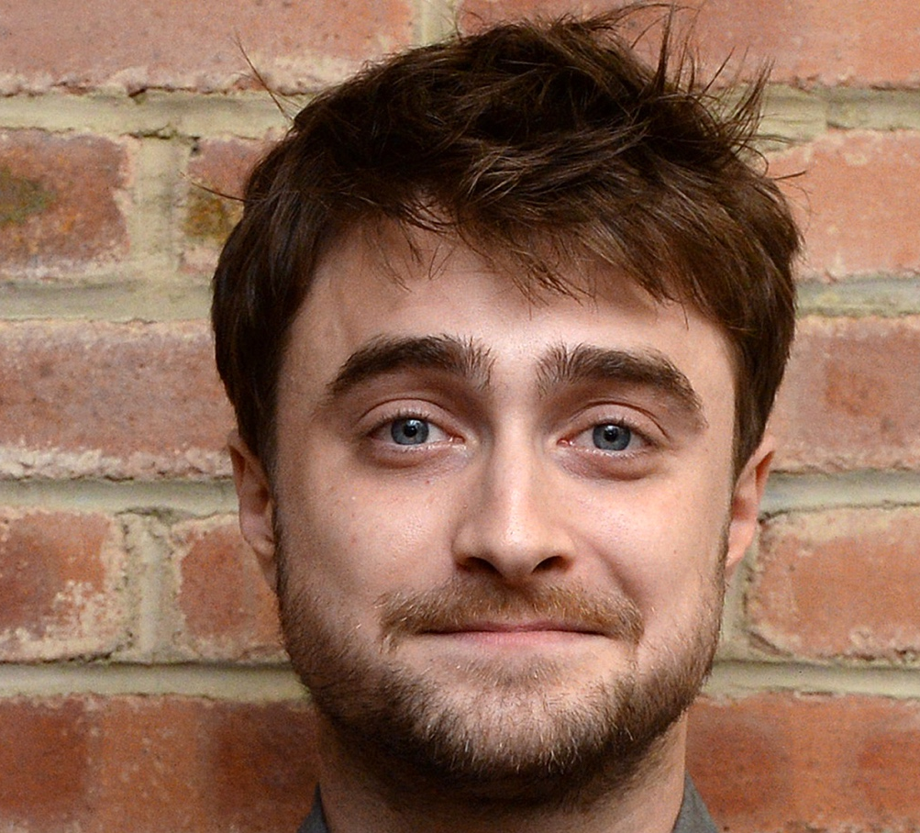
Target Persona
Background
Age: 26 years old
Education: Bachelor’s Degree
Location: California, USA
Job Title: Analyst
Email: Daniel2093@gmail.com
Annual Income: 500000 USD
Needs
Better Work/Life Balance
Growth in a Big Company
Love what I do
Become more technical
Balance between career expectations and family
Being my own boss
Educational content that provides: Quality and environmental friendliness
Target Persona
Daniel Krum
Free Time Activities
Watching movies and TV with friends
Sailing
Reading marketing/digital marketing articles
Biking Traveling
Cooking and baking
Reading, Writing
Spending time outside - swimming, kayaking, snow shoeing
Enjoy live music and travel
Hang out with kids and play basketball
Goals
To be a great marketer
Build something impactful
Want to be the owner of my life
Growth in current role
Would like to be an entrepreneur managing digital marketing for businesses, and have a successful drop shipping business.
Want to be working remotely as a Social Media Marketer/Manager or want to be running my own Affiliate Marketing brand/business
Professionally, want to be working remotely as a Social Media Marketer/Manager or want to be running my own Affiliate Marketing brand/business
To have a remote job as a digital marketer by March 2019. To travel to all 50 states by December 2019
More passion focused
Barriers
Travel time to work
From a small town, lack of marketing opportunity here outside of being a freelancer
Lack of time
Obtaining a degree that doesn't help get the jobs
Work Over 40 Hours Weekly
Price of Nanodegree programs
Mental barriers, hesitation
Lacking skills to do the job

Slide 6
TARGET AUDIENCE:
Demographics: people in their 20-40s
Location: USA
Interest: Digital Marketing, Social media marketing,
online advertising, entrepreneurship, small businesses,
digital nomad, travel, reading books, swimming
AD COPY
CAMPAIGN
SUMMARY
Want to be a great marketer?
Grab your free ebook to keep abreast about the advertising techniques on leading social media platforms!

Slide 7
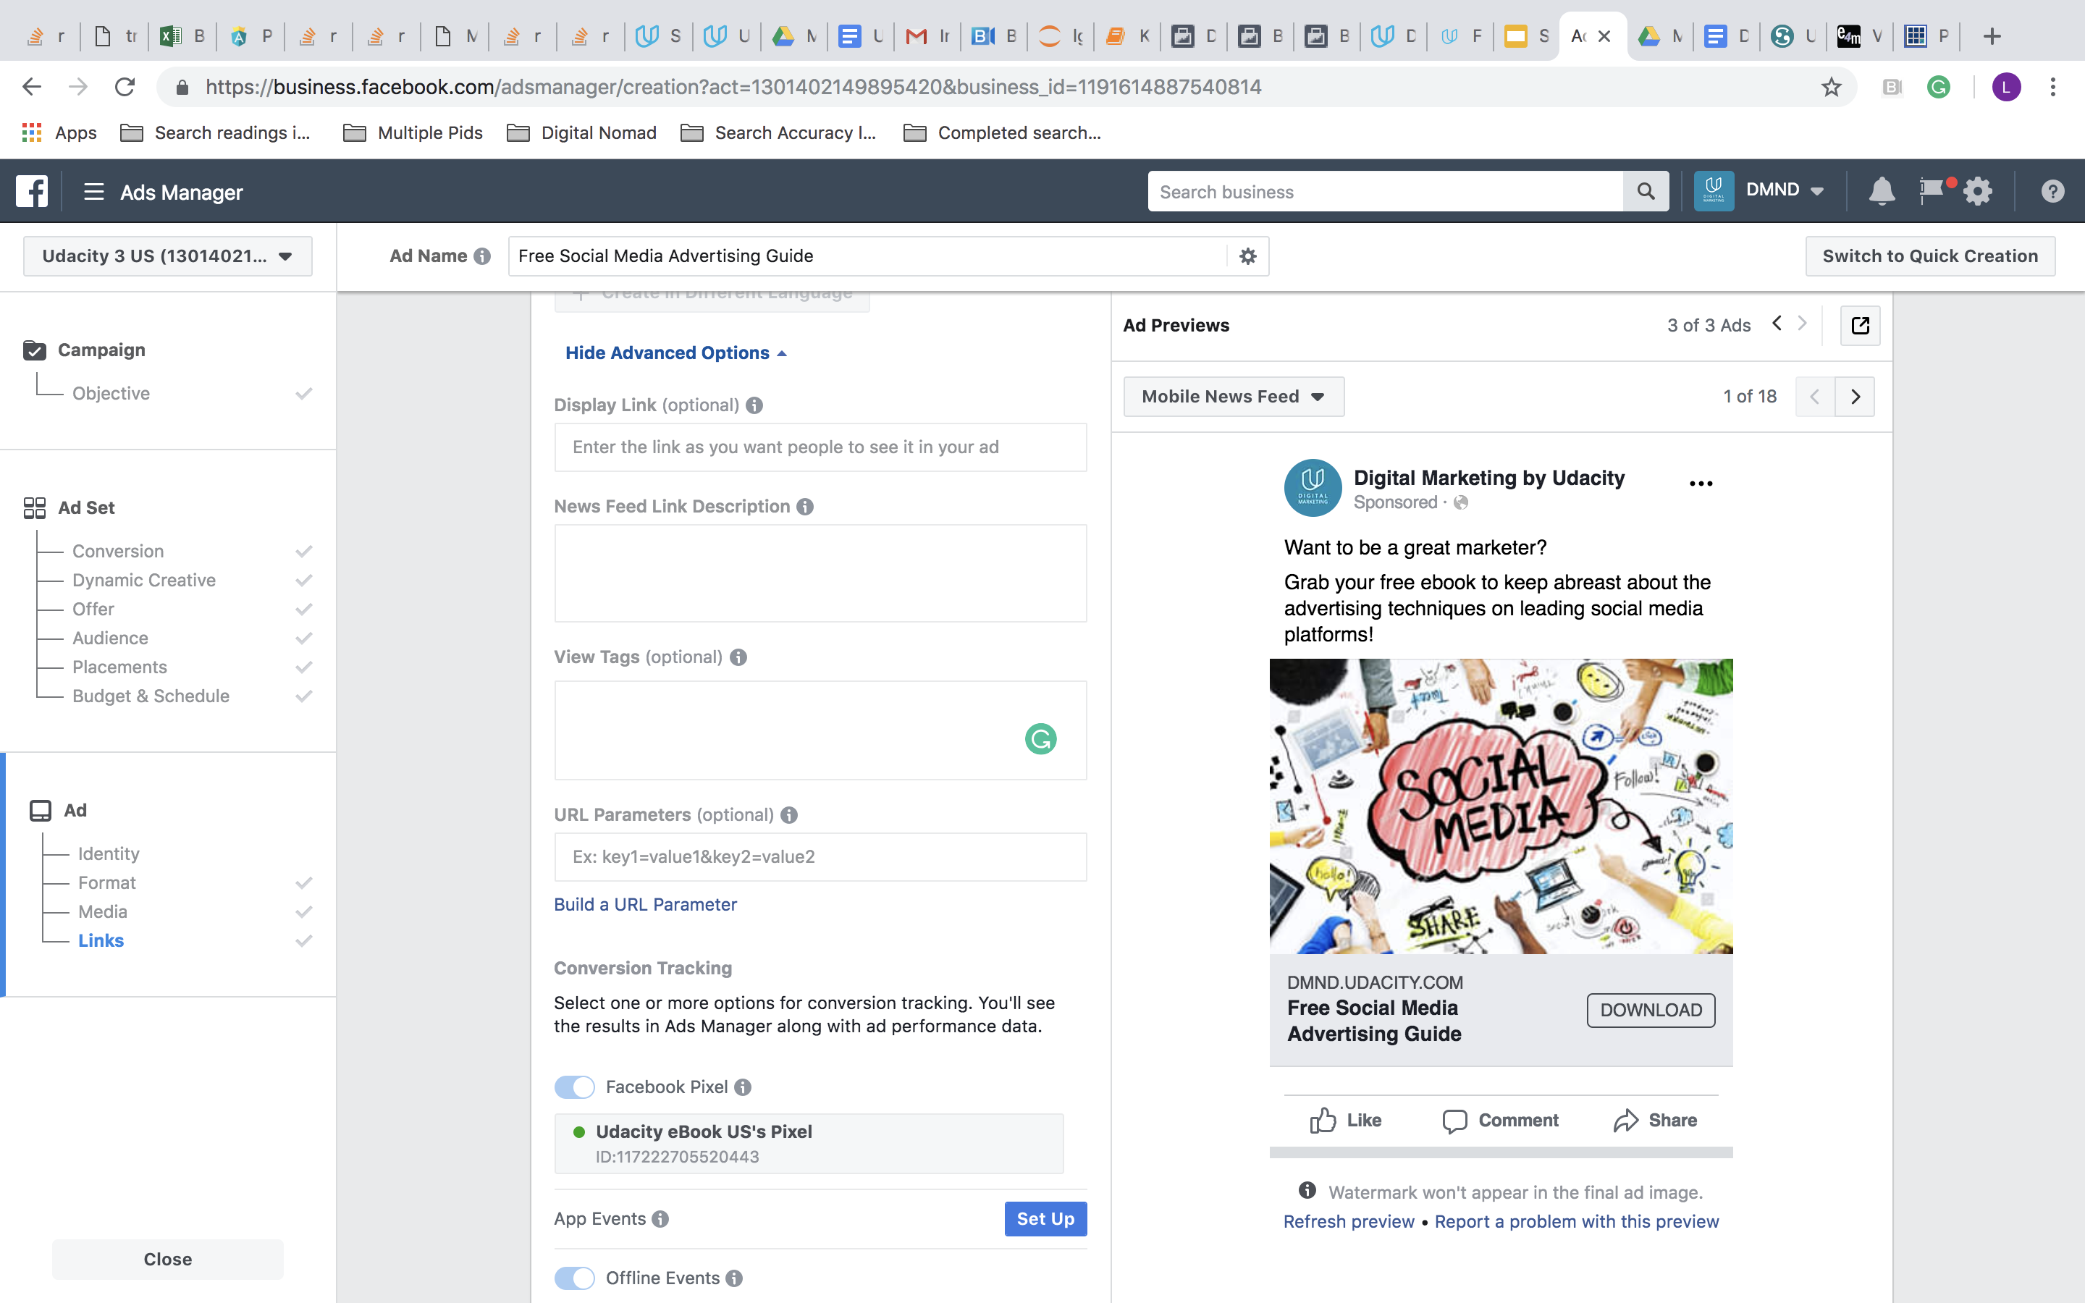
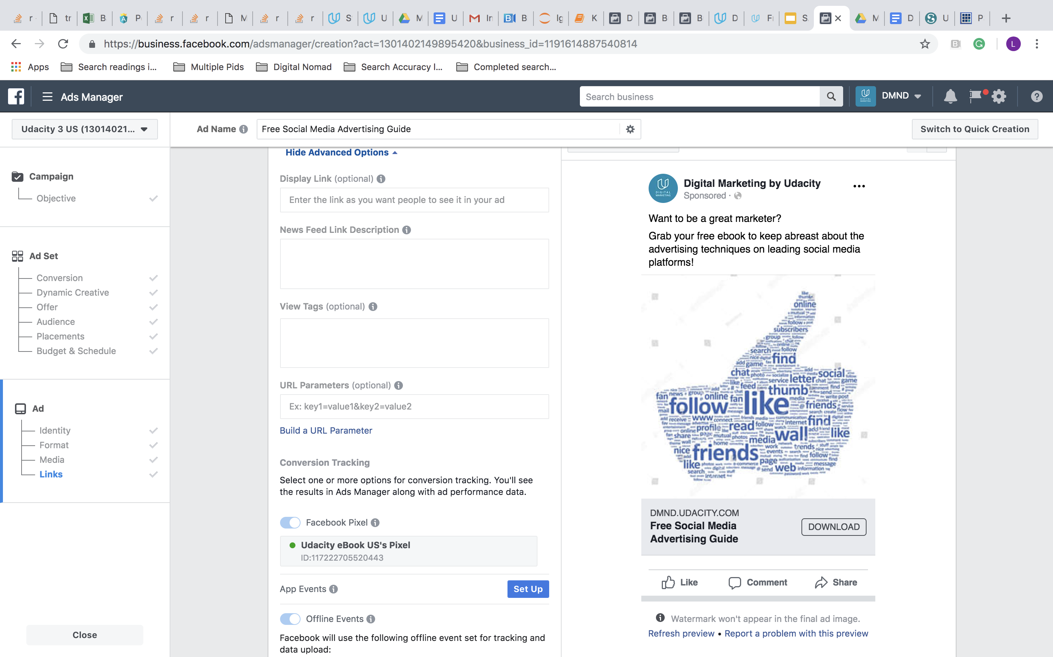
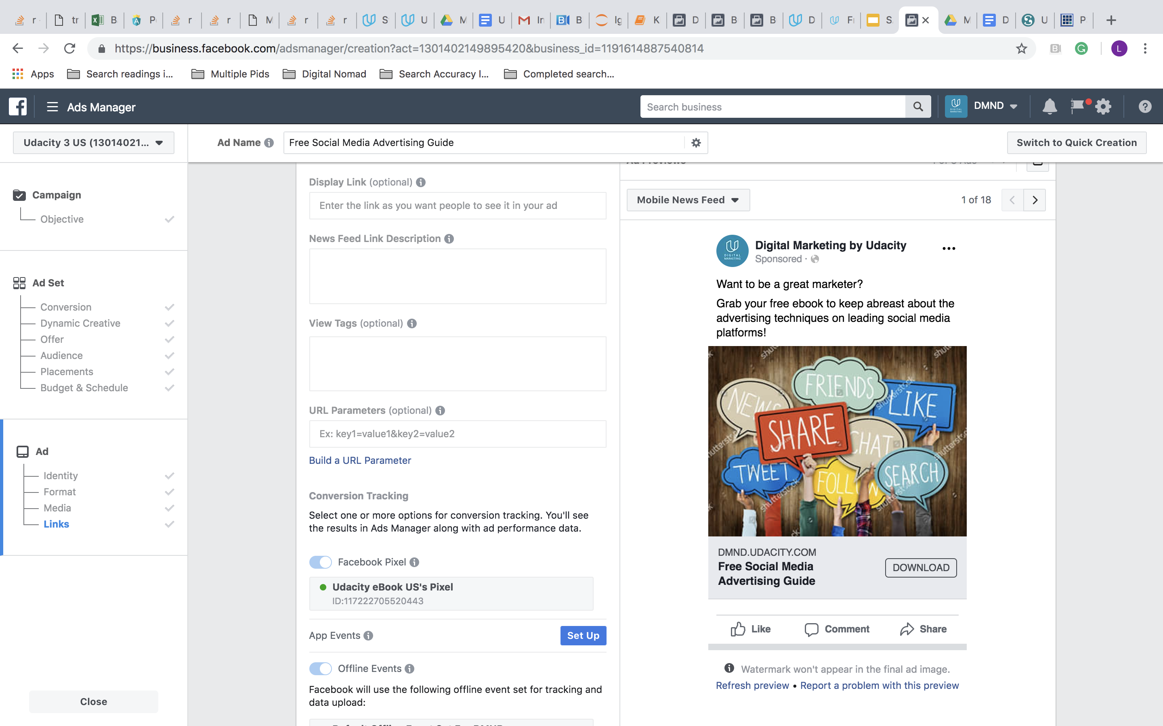
AD CREATIVES- INTIAL
Ad Creatives

Slide 8
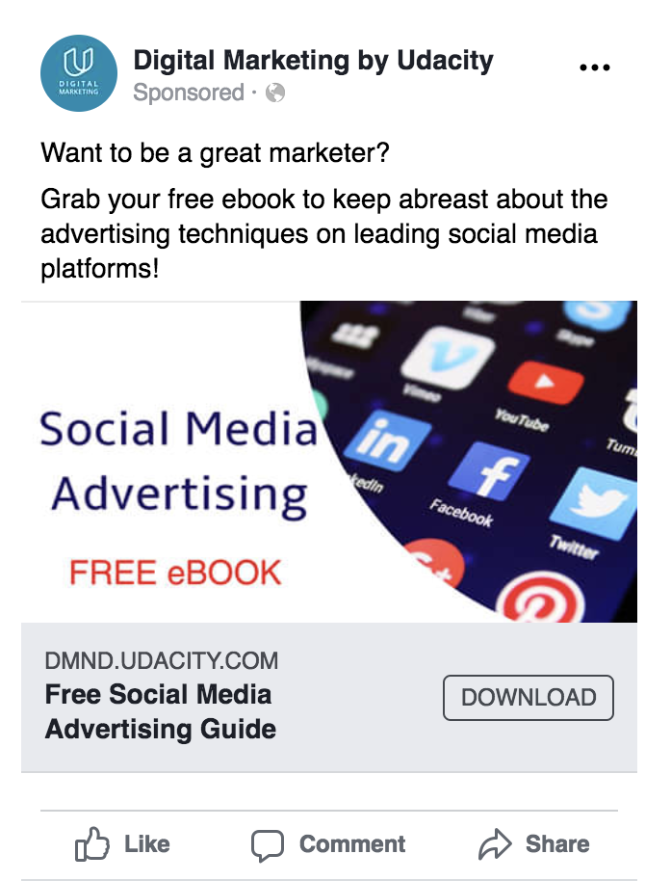
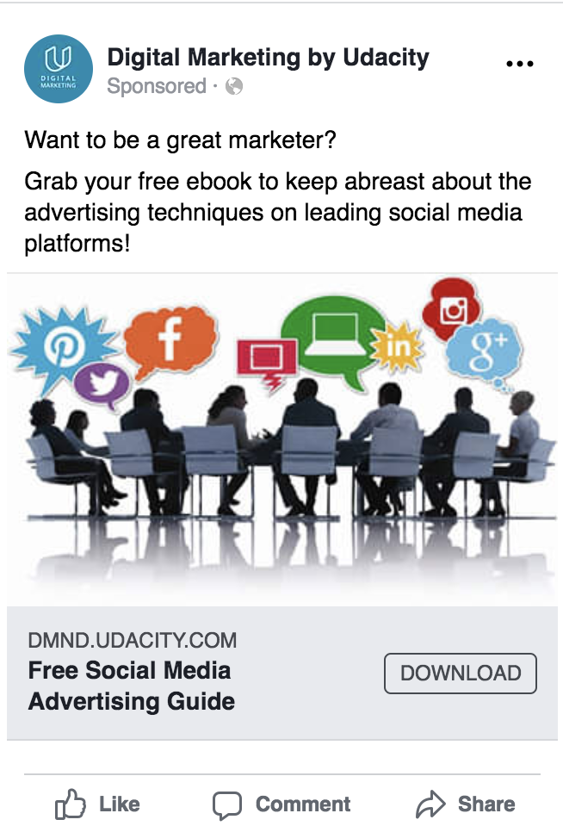
AD CREATIVES- AFTER CHANGES MADE
Ad Creatives
I changed the ad-images since some ad images had greater use of text. I wanted to see the impact of using less text in an ad

Slide 9
Campaign | Reach | Impressions | Cost per 1000 people reached | Amount Spent | Link Clicks | CPM | CPC
Ad One | 2307 | 2933 | $9.94 | $22.94 | 7 | $7.82 | $3.28
Ad Two | 968 | 1124 | $8.48 | $8.21 | 1 | $7.30 | $8.21
Ad Three | 6455 | 12034 | $10.67 | $68.85 | 6 | $5.72 | $11.48
Overall | 8207 | 16091 | $12.18 | $100 | 14 | $6.21 | $7.14
KEY RESULTS

Slide 10
There were zero e-book downloads since my Udacity pixel wasn’t working. I did email the support, but there has been no response yet.
The mentor in the group told to leave a note about this for the reviewer
According to my marketing objective, to convert 150 people by having them download the eBook, the campaign was a failure.
The main reason would be the Udacity pixel not working. I presume the problem was also because of competition.
I guess my ads were pushed down as many other Students had already placed similar ads for Udacity before me.
On a holistic view, the overall number of impressions of 16,091 for 3 ads was good. The average cost to reach 1,000 people was $12.18
“Image 3” is the most expensive and with the most reach at $10.67 and 6,455 people respectively.
I would actually say ad 1 performed the best compared to the other ads with a moderate reach of 2307 at a moderate cost of $9.94 per1000 people
reached and a low CPC of $4.06
CAMPAIGN evaluation- PART 1

Slide 11
ADDITIONAL BUDGET
I would approach my campaign by including women in the target persona and change nothing else about the demographics
I would use different ad copies for different ad images
I would segment the target audience into different segments like graduates, college professors, business professionals aspiring to become marketers,
business professionals already in the industry and use different ad creatives for the target segment
I would change the ad creatives to better suit the location audience segment
CAMPAIGN evaluation- PART 2

Slide 12
Appendix
Screenshots for Reference

Slide 13
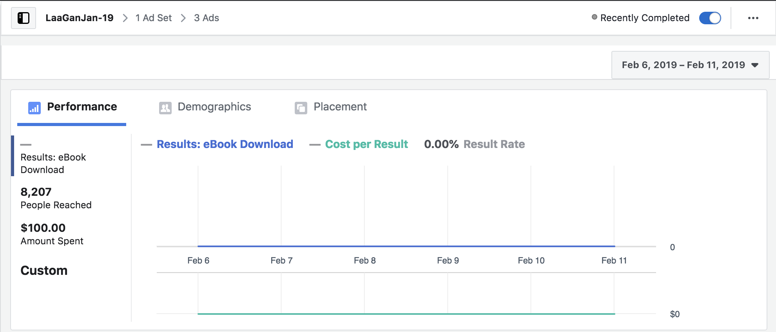
CAMPAIGN RESULTS: PERFORMANCE

Slide 14
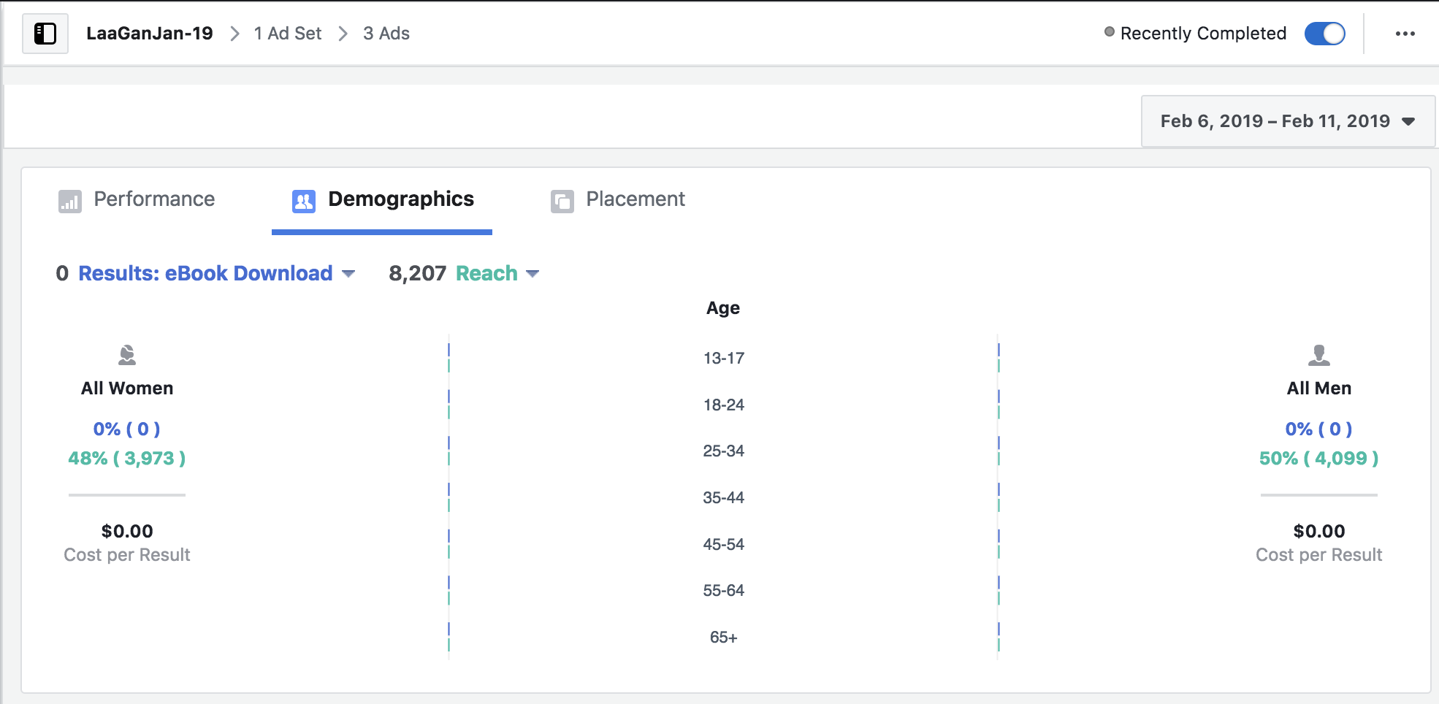
CAMPAIGN RESULTS: DEMOGRAPHICS

Slide 15
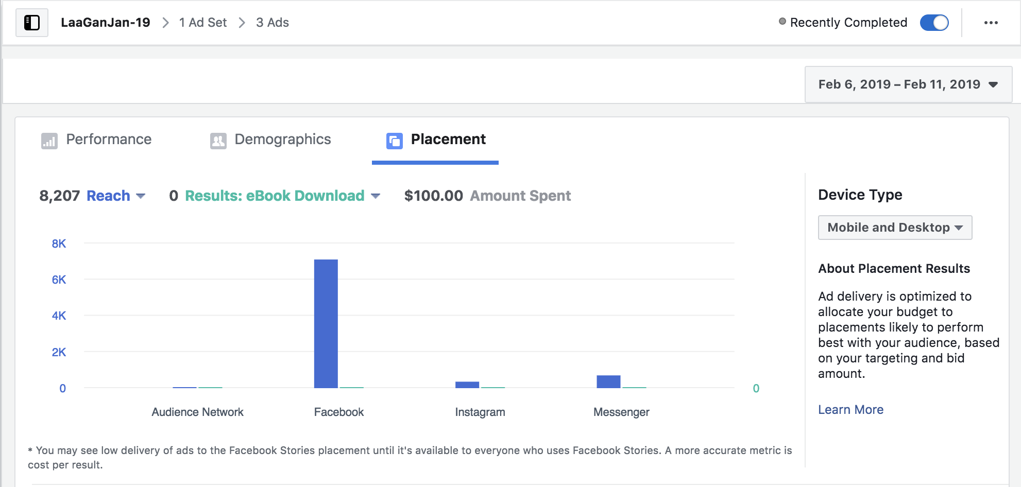
CAMPAIGN RESULTS: PLACEMENT

Slide 16
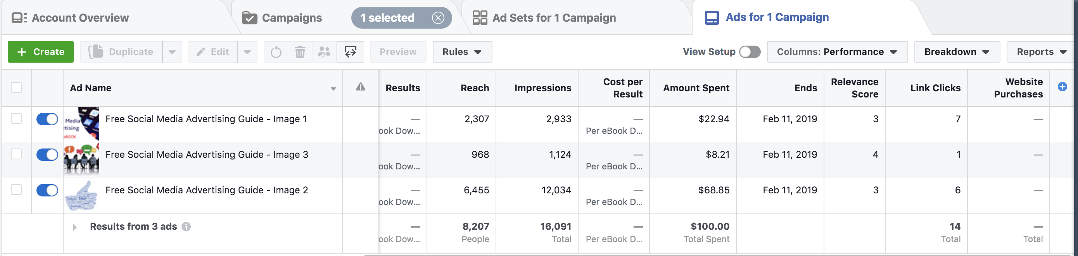
AD SET RESULTS: PERFORMANCE

Slide 17
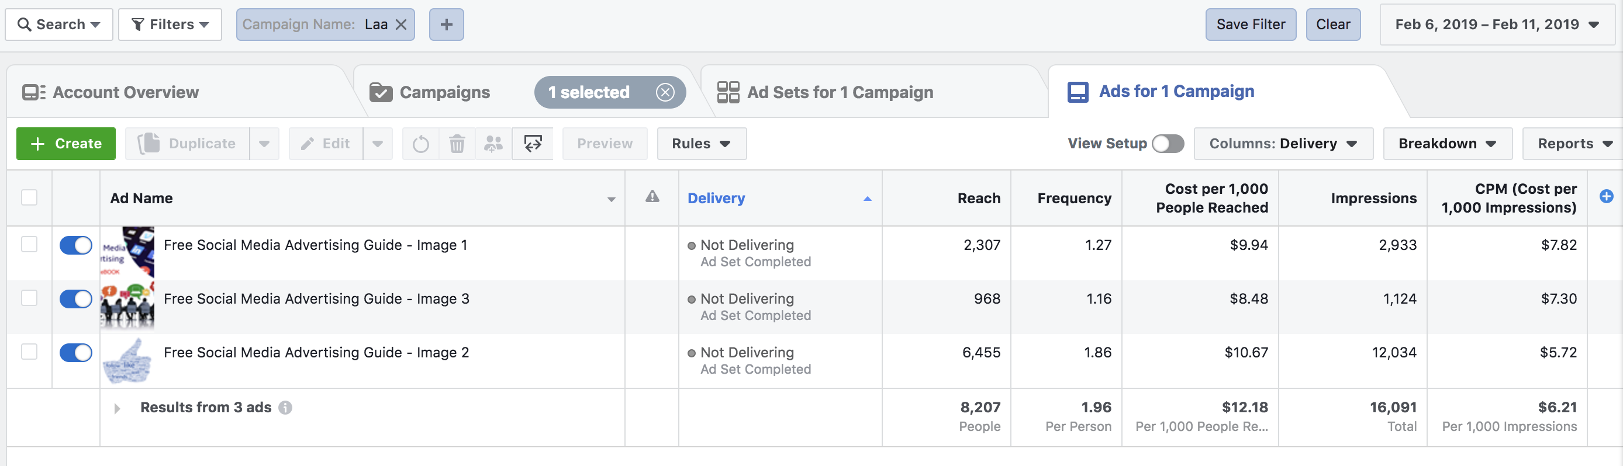
AD SET RESULTS: DELIVERY

Slide 18
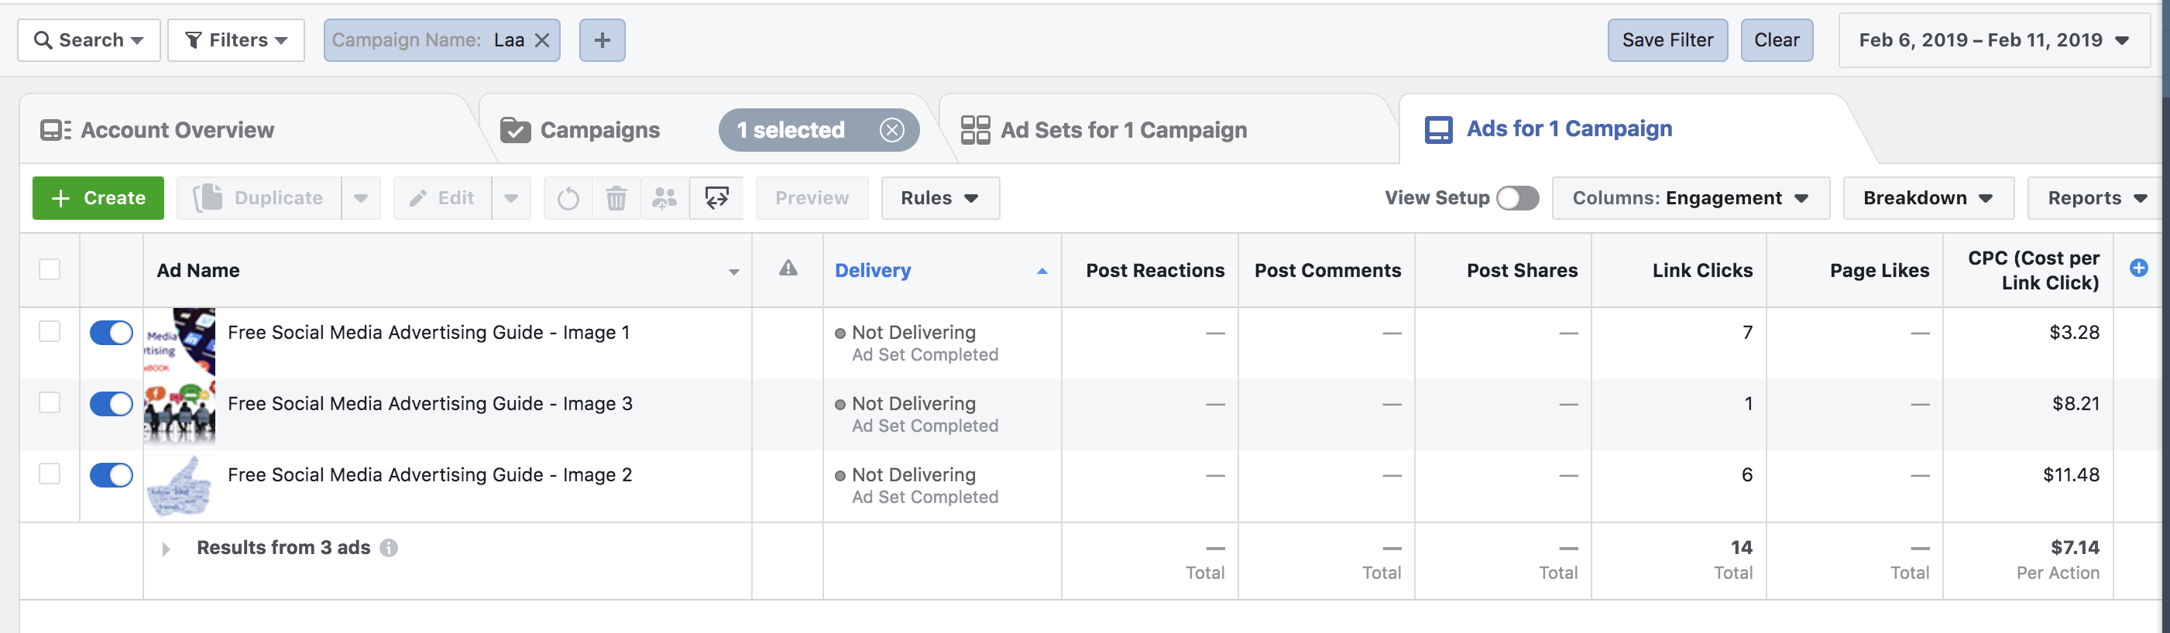
AD SET RESULTS: ENGAGEMENT

